Slide 1
Presented by: Zeeshan Muzammal BSCS13010 Ayesha Asghar BSCS13033 Arslan Ahmad BSCS13023 Abdul Monam BSCS13039
Presented To:
Dr. Zubair Malik

Slide 2
Introduction
Problem Domain
We are providing a platform for Citizen Journalism.
We are restricted to Pakistan’s data only
Motivation
Now a days, we get news and all information through news channels, newspapers or from social media. That information could be biased because a single person, news channels cannot represent public point of view on specific issue.

Slide 3
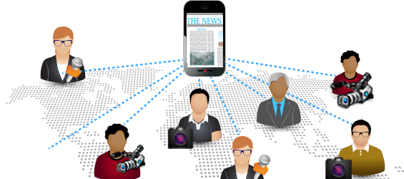
Citizen Journalism
In Citizen journalism People without professional journalism training use tools of modern technology to express their point of view on activities and news happening around them to considering it as a news.
It is public participatory reporting

Slide 4
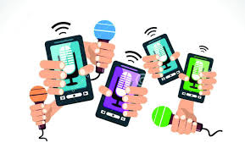
Cont’d
We decided to implement idea of Citizen Journalism through twitter
Decided to get tweet of different news channels
Anchor and general public.

Slide 5
Goal and Objectives
Providing platform for Citizen Journalism
It would be a central information (news) based platform(website)
Providing unbiased news
Trying to fill the gap between T.V news and public news
Informing about local issues of Pakistan

Slide 6
Need finding Methodologies
Did interview of 6 people
Make questionnaire before interview
Interview people, age group from 20-28
Mostly people of this group are more active on social sites
Know importance of their point of view
Did random sampling

Slide 7
Need finding Methodologies
Why do we choose these people ?
People from diverse background
Diverse point of view
Professionals have experience based knowledge
Students

Slide 8
Results of interview
People were excited about our project
Social media was the source of information
Facebook and twitter
Type of information they post is secondary

Slide 9
Result Cont’d
Our assumption gone wrong
We assume if not everyone but mostly people will have twitter account
Consider news biased towards specific party, person etc
Follow news channels through their social web pages
Post information related to technology, politics and personal affairs on social sites

Slide 10
Analysis
They were very critical against the behavior of current news channels
During question related to TV channels they get hyper against politician
Their behavior was friendly
There environment looks good. They look as new technology user
They were using laptop and mobile.
They said their day passed happily
We infer they want un-biased news from some source

Slide 11
Summary
Aim is to provide platform on concept know as Citizen Journalism
Available sources of information can be biased
Information related to categories like:
Politics
Technology
Entertainment
People appreciate this platform and excited about this
Personalize news is interesting thing for people

